Slide 1





CITY TRAFFIC
SELF DRIVING CARS
A new approach to AI

Slide 2

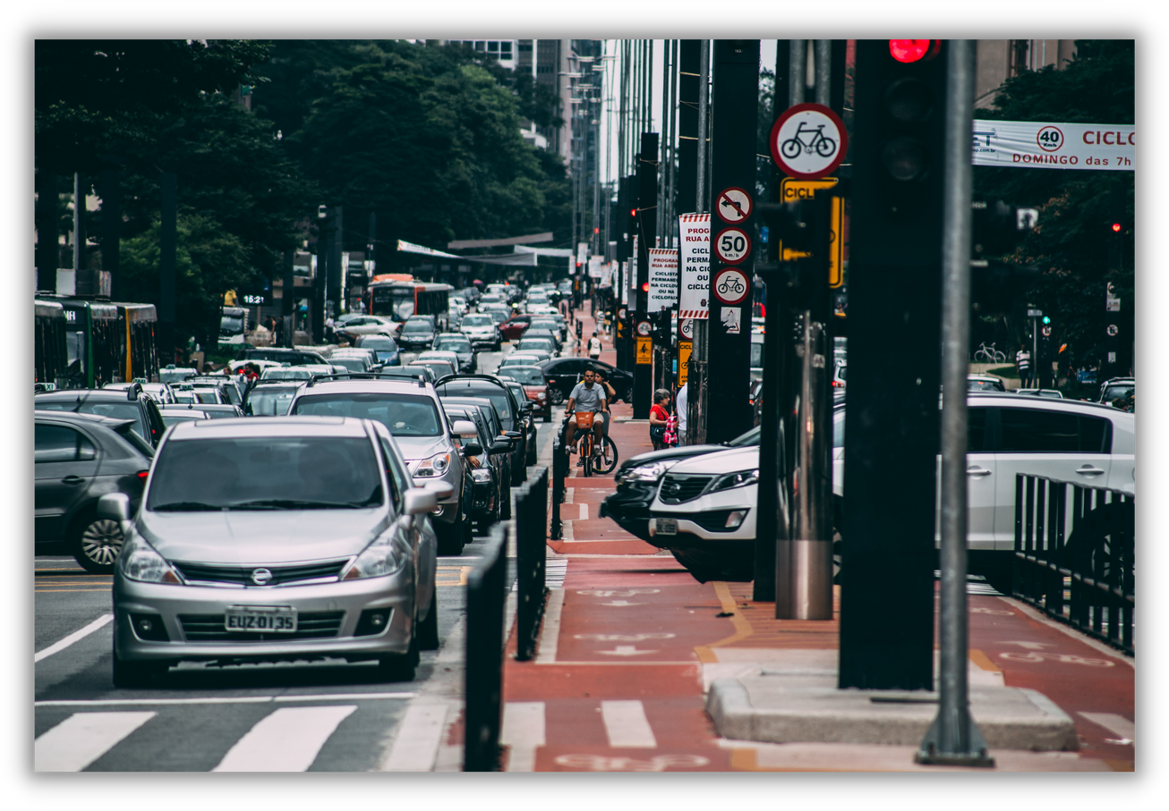
TEAM NAME and MEMBER DETAILS
Vaishnavi Kale
Hansika Amrutkar
Isha Singhal
THEME : City Traffic

Slide 3
TRAFFIC SIGN DETECTION FOR AUTONOMOUS SELF-DRIVING CARS

Slide 4
OBJECTIVE
To encourage driverless cars as it would decrease the traffic problem and to automate cars as it would decrease the traveling cost

Slide 5
Methodology
We have used various libraries in python like Keras, Math, Pickle, time, Textwrap, Numpy, Matplotlib, cv2, TensorFlow, etc. for creating the model. We have implemented a deep learning model that learns to recognize traffic signs. We implemented Convolutional Neural Network to train the German traffic sign dataset and then tested it on the Dataset. We achieved an accuracy of 93% for the model.

Slide 6

Limitations
Not all Indian Roads have traffic sign dataset
Physical and Geographical Challenges
1% error

Slide 7

Future Scope
The traffic signs detector and classifier focus on the reduction of the traffic load on the existing road network through various travel demand management measures.
We plan to add the traffic sign info on the map of the application similar to google Maps and add the digital signs there along with using this model.
Detecting and recognizing a sign, thus notifying the driver of any upcoming signs

Slide 8
Training Datset Results
Training...
EPOCH 1 ... Validation Accuracy = 0.747 EPOCH 2 ... Validation Accuracy = 0.849 EPOCH 3 ... Validation Accuracy = 0.886 EPOCH 4 ... Validation Accuracy = 0.896 EPOCH 5 ... Validation Accuracy = 0.917 EPOCH 6 ... Validation Accuracy = 0.922 EPOCH 7 ... Validation Accuracy = 0.918 EPOCH 8 ... Validation Accuracy = 0.929 EPOCH 9 ... Validation Accuracy = 0.922 EPOCH 10 ... Validation Accuracy = 0.933 EPOCH 11 ... Validation Accuracy = 0.935 EPOCH 12 ... Validation Accuracy = 0.930 EPOCH 13 ... Validation Accuracy = 0.937 EPOCH 14 ... Validation Accuracy = 0.938 EPOCH 15 ... Validation Accuracy = 0.940 EPOCH 16 ... Validation Accuracy = 0.933 EPOCH 17 ... Validation Accuracy = 0.941 EPOCH 18 ... Validation Accuracy = 0.949 EPOCH 19 ... Validation Accuracy = 0.944 EPOCH 20 ... Validation Accuracy = 0.946 EPOCH 21 ... Validation Accuracy = 0.939 EPOCH 22 ... Validation Accuracy = 0.950 EPOCH 23 ... Validation Accuracy = 0.939 EPOCH 24 ... Validation Accuracy = 0.945 EPOCH 25 ... Validation Accuracy = 0.951 EPOCH 26 ... Validation Accuracy = 0.948 EPOCH 27 ... Validation Accuracy = 0.945 EPOCH 28 ... Validation Accuracy = 0.943 EPOCH 29 ... Validation Accuracy = 0.947 EPOCH 30 ... Validation Accuracy = 0.956 EPOCH 31 ... Validation Accuracy = 0.945 EPOCH 32 ... Validation Accuracy = 0.948 EPOCH 33 ... Validation Accuracy = 0.954 EPOCH 34 ... Validation Accuracy = 0.952 EPOCH 35 ... Validation Accuracy = 0.940 EPOCH 36 ... Validation Accuracy = 0.953 EPOCH 37 ... Validation Accuracy = 0.948 EPOCH 38 ... Validation Accuracy = 0.949 EPOCH 39 ... Validation Accuracy = 0.946 EPOCH 40 ... Validation Accuracy = 0.946 EPOCH 41 ... Validation Accuracy = 0.947 EPOCH 42 ... Validation Accuracy = 0.952 EPOCH 43 ... Validation Accuracy = 0.951 EPOCH 44 ... Validation Accuracy = 0.946 EPOCH 45 ... Validation Accuracy = 0.953 EPOCH 46 ... Validation Accuracy = 0.948 EPOCH 47 ... Validation Accuracy = 0.958 EPOCH 48 ... Validation Accuracy = 0.951 EPOCH 49 ... Validation Accuracy = 0.959 EPOCH 50 ... Validation Accuracy = 0.947 Model saved

Slide 9
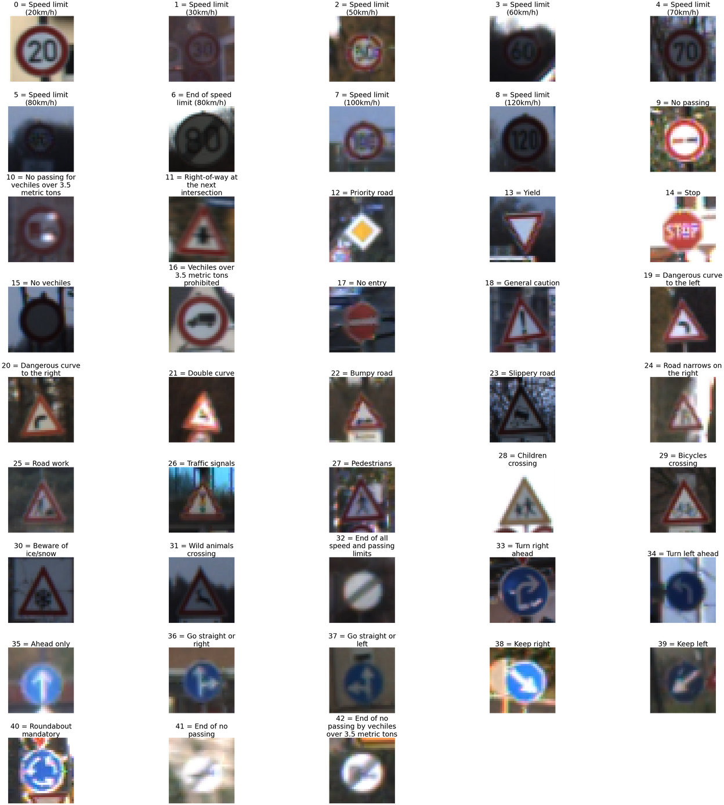
Classification

Slide 10
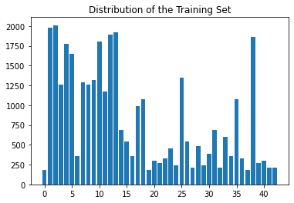
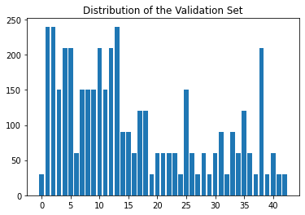
Graphs

Slide 11
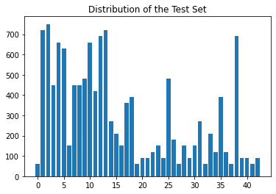
Graphs

Slide 12
Result
Training set accuracy = 0.999
Validation set accuracy = 0.947
Test set accuracy = 0.937

Slide 13
THANKS
FOR WATCHING

